Slide 1
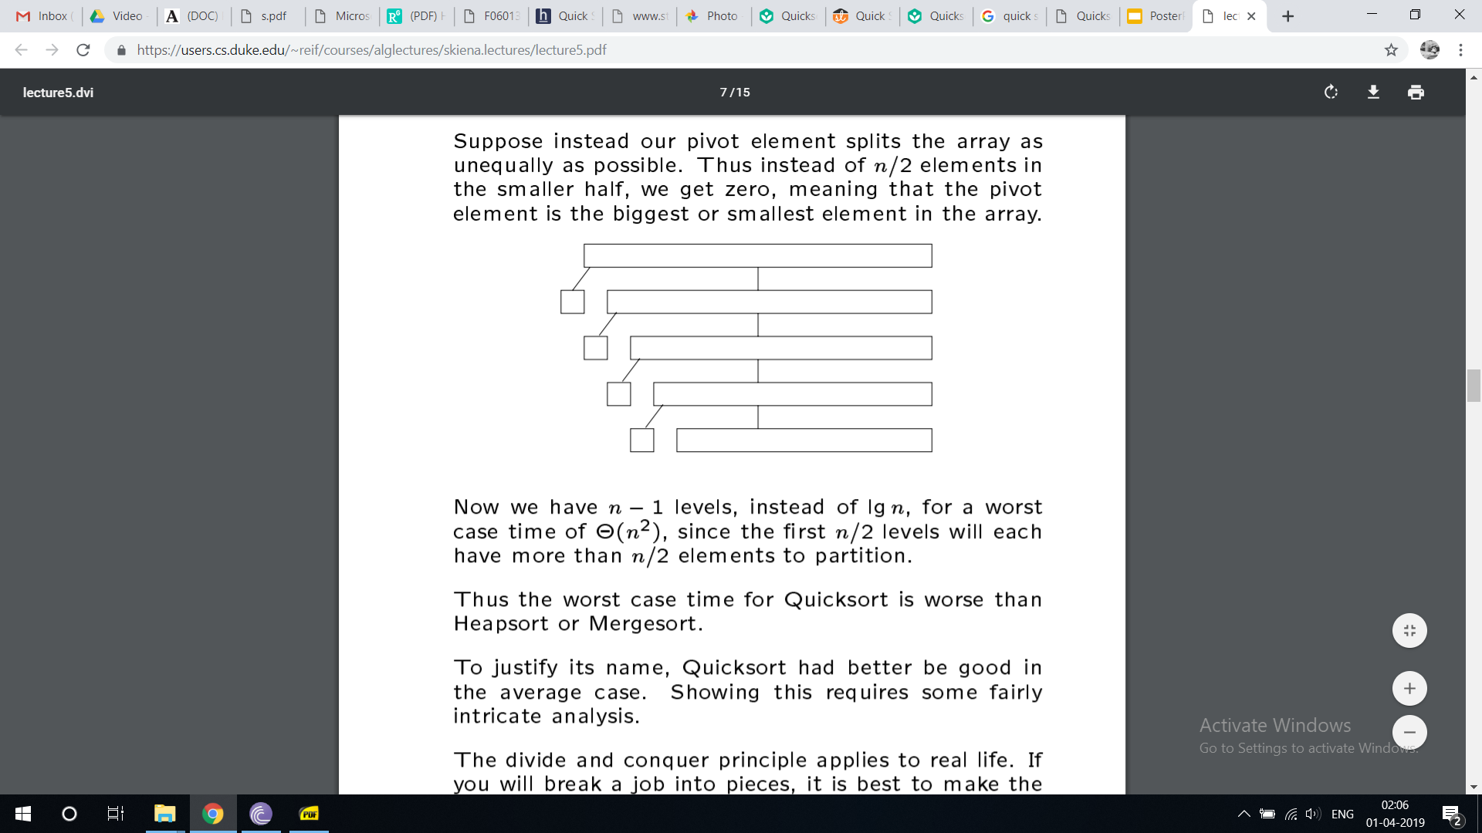
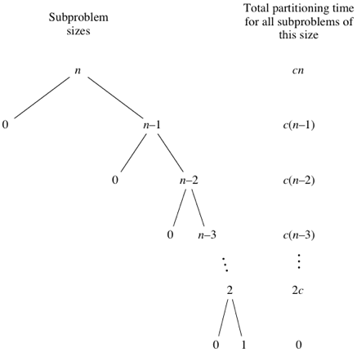
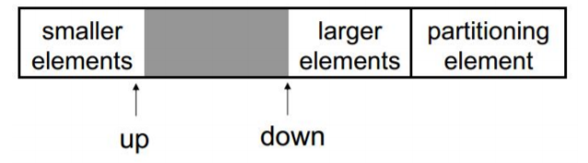
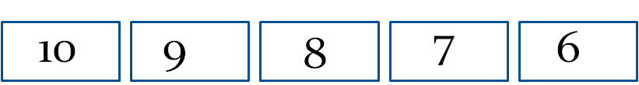
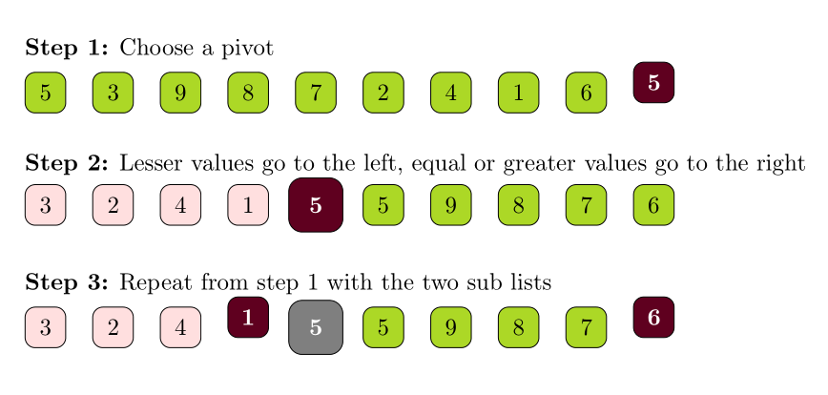
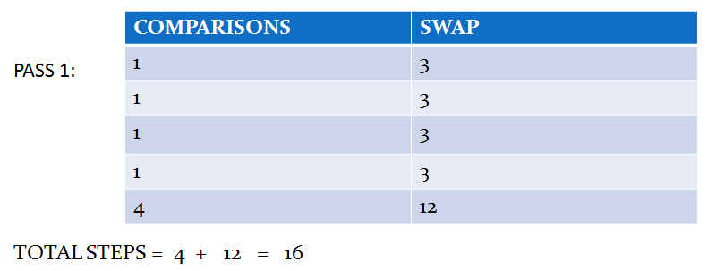
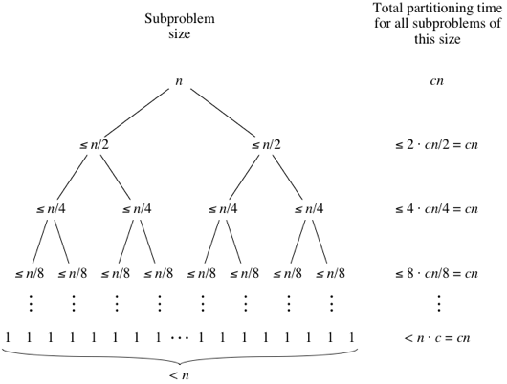

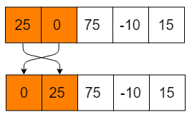
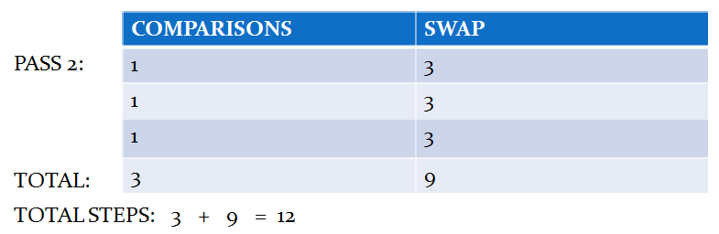

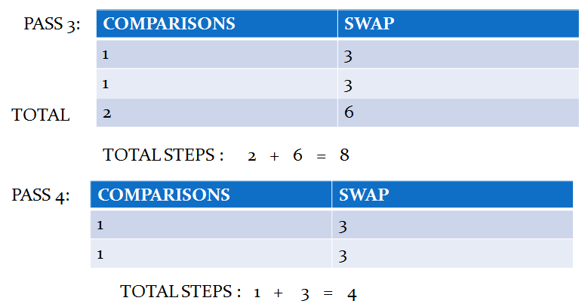
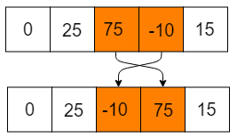
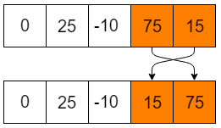
Best case, Average case and Worst case of Bubble Sort and Quick Sort
Presented By
NISHITA AISHWARYA (2018450001), HAMMAD ANSARI (2018450002)
BUBBLE SORT INTRODUCTION
WORST CASE AND BEST CASE COMPLEXITY
QUICKSORT
WORST CASE AND BEST CASE COMPLEXITY
Bubble sort is a stable, comparison and in-place sorting algorithm, which compares adjacent elements of a list, and swaps them if they are not in the desired order. It repeatedly cycles through the list until the elements are all sorted. It is also called as sinking sort .
The name ‘bubble sort’ is derived from the fact that the largest element in the list ‘bubbles’ to the top, or the end of the list.
LOGIC
if ( element > next element)
swap
else
don’t swap
move to the next element
This keeps on repeating till all the elements get sorted in the array.
FOR WORST CASE COMPLEXITY, all the elements in the array are taken in descending order , so that maximum number of comparisons and swaps are made which decreases the efficiency of sorting algorithm.
In Bubble Sort, n-1 comparisons will be done in the 1st pass, n-2 in 2nd pass, n-3 in 3rd pass and so on. So the total number of comparisons will be,
(n-1) + (n-2) + (n-3) + ..... + 3 + 2 + 1
Sum = n(n-1)/2
i.e O(n^2)
FOR BEST CASE COMPLEXITY, all the elements in the array are taken in ascending order , so that minimum number of comparisons and swaps are made which increases the efficiency of the sorting algorithm.
In Bubble Sort, n-1 comparisons are made in the first pass and since all the elements are already sorted , total number of passes will be 1 only and the number of comparisons will be ( n - 1) only.
( n - 1 ) i.e O( n )
AVERAGE CASE COMPLEXITY , of Bubble sort is also O( n^2 )
CALCULATION OF WORST CASE COMPLEXITY:
CALCULATION OF COMPLEXITY :
16+ 12 + 8 + 4 = 4 ( 4 + 3 + 2 + 1 )
= 4 ( (n-1) + (n-2) + _ _ _ ) = ( 4(n-1)n)/2 = 2n(n-1)
= 2n^2 - 2n
O(n) = n^2
ABSTRACT of Research Paper: To improve Bubble sort algorithm using bidirectional bubble sort, batchers sort and bitonic sort.
Introduction :-
Quick sort algorithm is a divide-and-conquer method for sorting. It works by partitioning an array into two parts and then, sorting each part independently. Partition plays major role in Quicksort processing time. Quicksort can be expected to be up to twice as fast as its nearest competitors.
Logic :-
Steps:-
Pick an element, say P(the pivot). Here it is the last element.
2) Re-arrange the elements into 3 sub-blocks,
1. Those less than or equal to <= P (the left-block)
2. P (the only element in the middle-block)
3. Those greater than or equal to >= P (the right-block)
3)Repeat the process recursively for the left and right sub-blocks.(That is the results of left-block,
Algorithm :-
Sort(A)
Quicksort(A, 1, n)
Quicksort(A, low, high)
if (low < high)
pivotlocation = Partition(A, low, high)
Quicksort(A, low, pivotlocation)
Quicksort(A, pivotlocation+1, high)
Partition(A, low, high)
pivot = A[low]
p = low
for i = low + 1 to high
if (A[i] < pivot) then
swap(A[i], A[p + 1])
p = p + 1
swap(pivot,A[p])
return (p)
For worst case complexity,
Suppose our pivot element splits the array as unevenly as possible. Thus instead of n/2 elements in the smaller half, we get zero, meaning that the pivot element is either the biggest or smallest element in the array.
The original call takes cn time for some constant c, the recursive call on n-1 elements takes c(n-1) time, the recursive call on n-2 elements takes c(n-2) time, and so on.
hence, the quicksort’s worst-case running time is Θ(n^2)
For best case complexity,
Best case is clearly opposite of worst case, here our pivot element splits the array equally in two parts. Thus we get n/2 element as our pivot on each and every partition method.
Each partition has (n-1)/2 elements, so we calculate the time
complexity as per the swapping between middle element times. Hence, the quicksort best-case running time is Θ(n log base 2 n)
ALGORITHM
function bubblesort(list x)
size = length(x)
for i = 1 to size
for j = 1 to size-1-i
if x[j] > x[j+1]
swap x[j] and x[j+1]
end if
end for
end for
end function
example:
Consider the following elements:
In the first iteration, the algorithm compares the first two elements with each other, and swaps them since they are not in increasing order:
The two elements are now sorted, so the algorithm moves to the next two elements and compares them. Since they are already in the correct order, they are not swapped:
The algorithm now compares the next two elements. They are not in the correct order, and are therefore swapped:
The last two elements are now compared. They are therefore swapped:
As you can now see, the largest element from the list is now in the last position, i.e., it is now in its final place.
Each comparison of elements is called an iteration, and once the algorithm cycles through the list once, and puts the largest element (from the ones being compared) in its place, one pass is said to be completed.
REFERENCES
https://www.researchgate.net/publication/228949866_Improving_the_performance_of_bubble_sort_using_a_modified_diminishing_increment_sorting
https://www.studytonight.com/data-structures/bubble-sort
https://www.khanacademy.org/computing/computer-science/algorithms/quick-sort/a/analysis-of-quicksort
https://www.studytonight.com/data-structures/quick-sort
https://www.algorithmist.com/index.php/Quicksort

